Slide 1
Chapter 27 Gauss’ Law

Slide 2









In Cartesian coordinate system

Slide 3



In Cartesian coordinate system

Slide 4





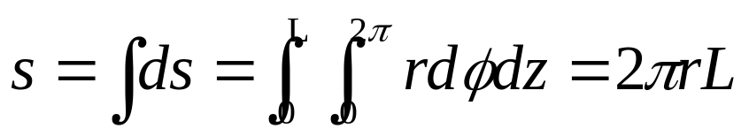



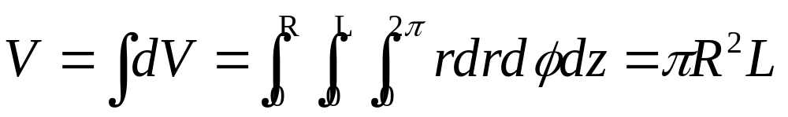
In Cylindrical coordinate system

Slide 5


In Cylindrical coordinate system

Slide 6

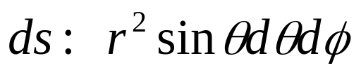

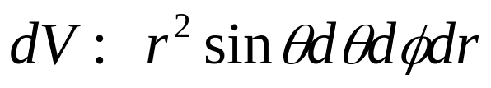

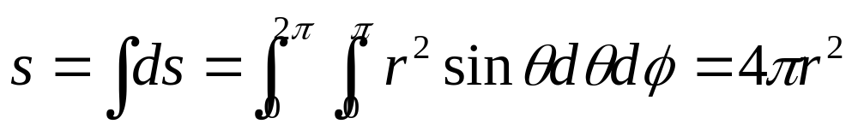
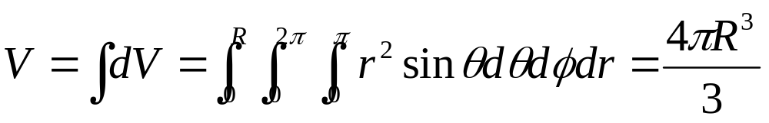
In Spherical coordinate system

Slide 7

In Spherical coordinate system

Slide 8
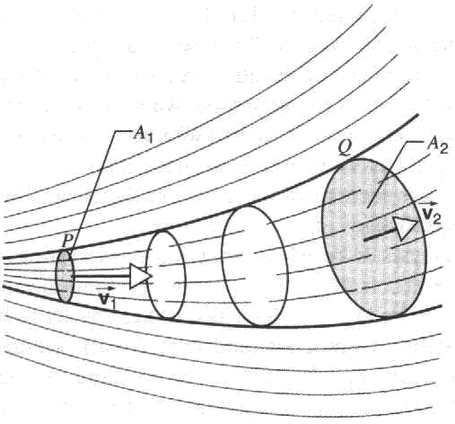
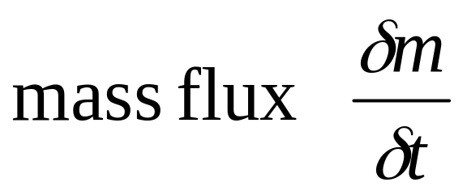
Flux of a Vector Field
mass flux at P = ρ₁A₁v₁ ,
mass flux at Q = ρ₂A₂v₂
volume flux Av

Slide 9
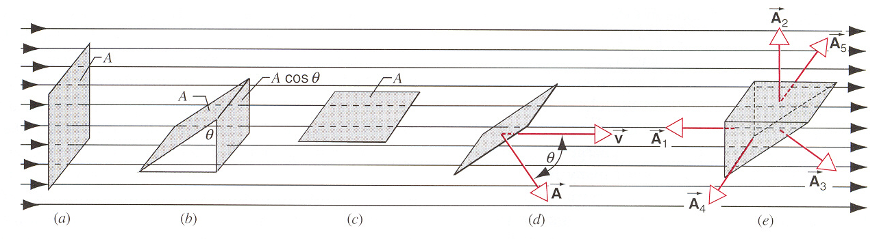
volume flux Av

Slide 10
volume flux Av
Acosθ

Slide 11
volume flux Av

Slide 12
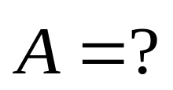
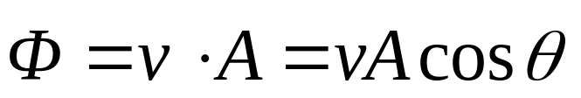
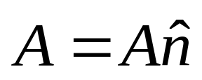
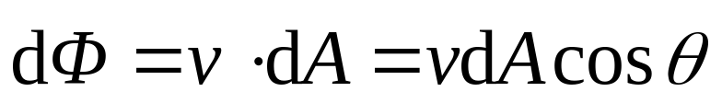
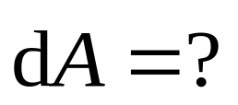
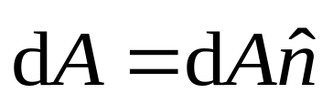
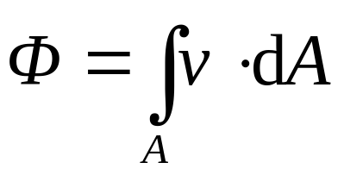
volume flux Av
Generally,

Slide 13
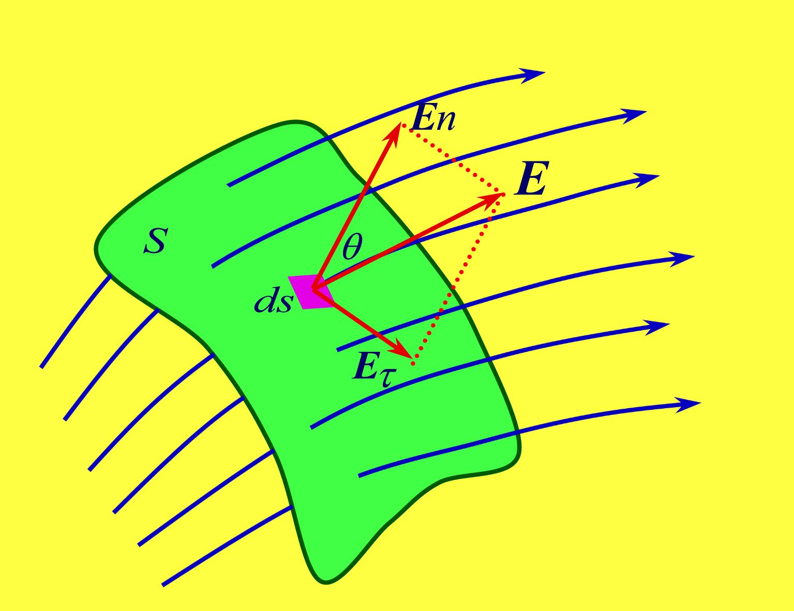
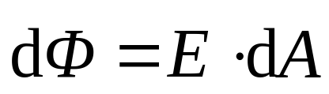
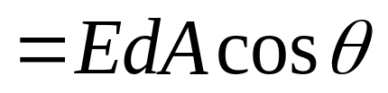
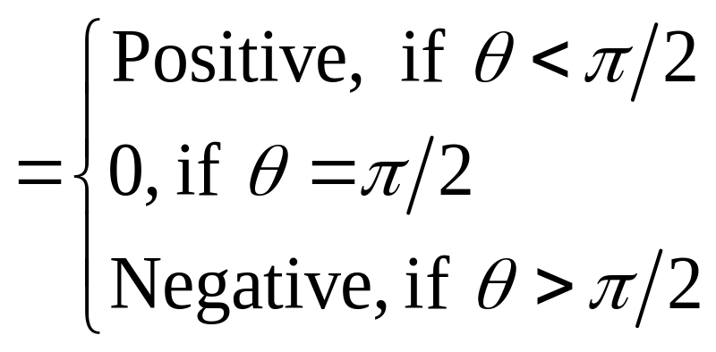
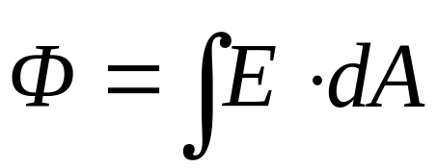
Flux of the Electric Field
A
dA
The flux of the electric field through the full surface A is then the surface integral of the field strength vector,

Slide 14
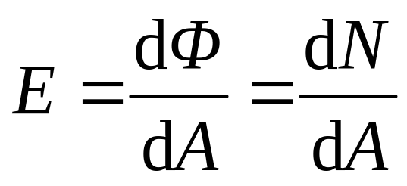
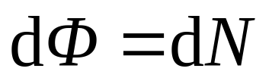
Flux of the Electric Field
A
dA
Geometrically, the flux can be understood as the number of the electric field lines through the surface.

Slide 15
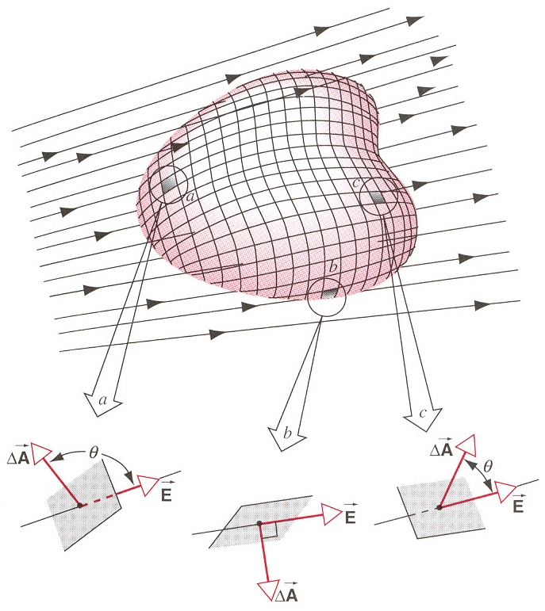
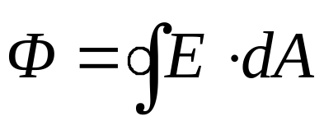
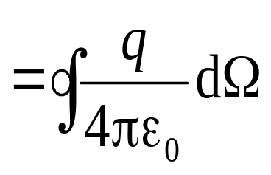
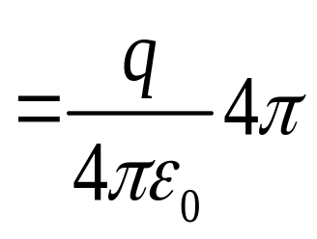
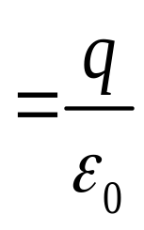
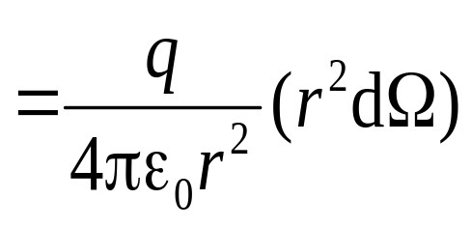
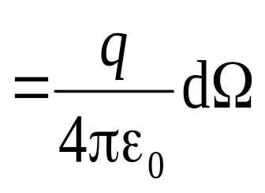
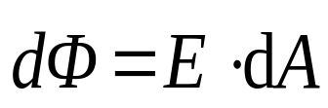
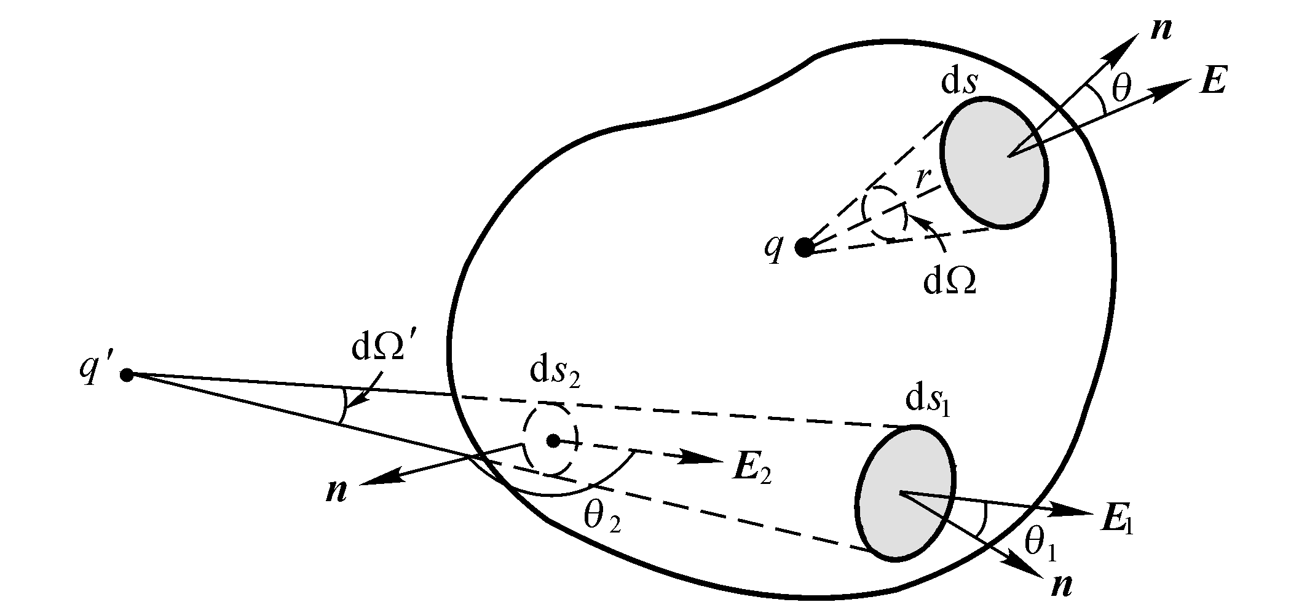
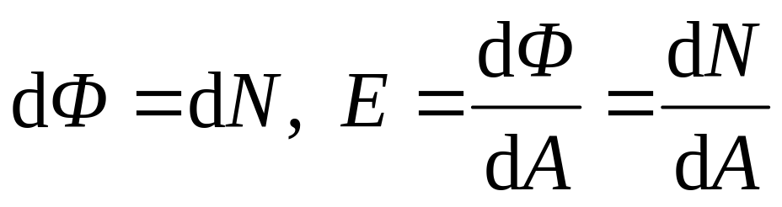
Here E is resultant electric field strength on the Gauss surface.
The flux of the electric field through the closed surface is represented as :
Geometrically, the flux can be understood as the number of the electric field lines through the surface.

Slide 16
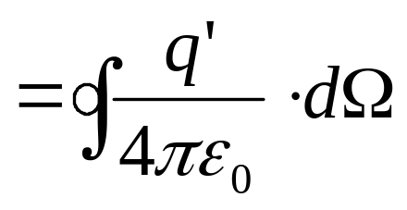

Here E is resultant electric field strength on the Gauss surface.
The flux of the electric field through the closed surface is represented as :
Geometrically, the flux can be understood as the number of the electric field lines through the surface.

Slide 17
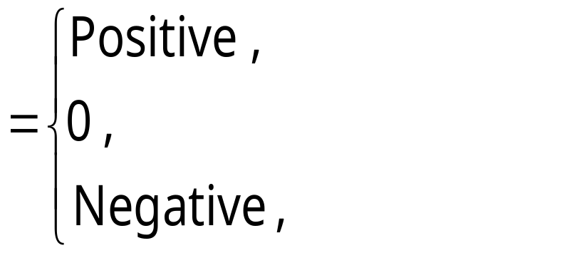
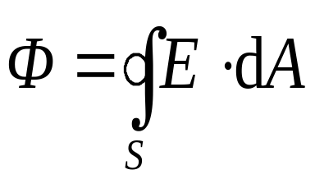
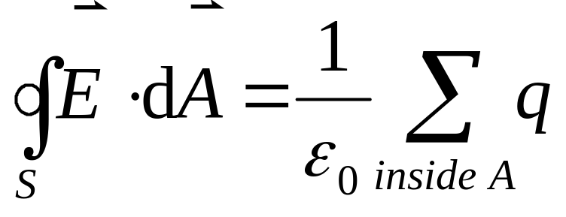
a positive charge inside A;
no net charge inside A;
a negative charge inside A;
This relation is called:
Gauss’ Law
Geometrically, the flux can be understood as the number of the electric field lines through the surface.

Slide 18
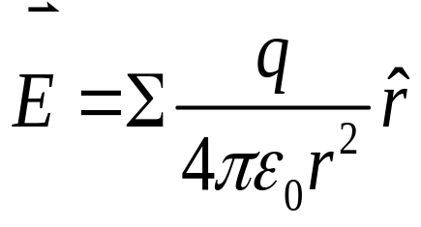
Coulomb’s law
Gauss’ law
Gauss’ law is more general than Coulomb’s law.
(1) offers a much simpler way to calculate electric fields in situations with a high degree of symmetry.
(2) illustrates more clearly the relationship between electric and magnetic fields.
(3) is valid in the case of rapidly moving charges.
(4) can derive Coulomb’s law.

Slide 19
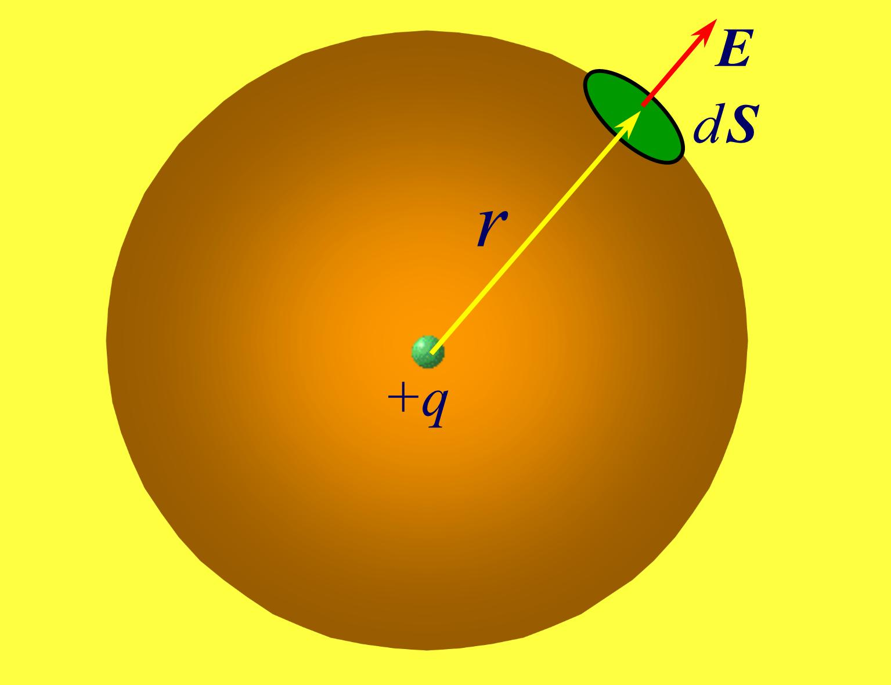
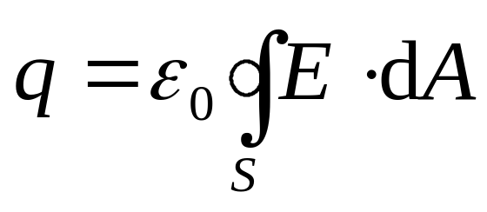
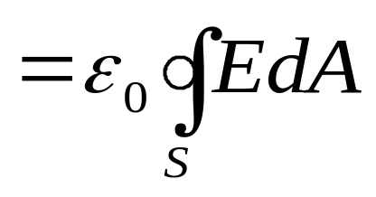
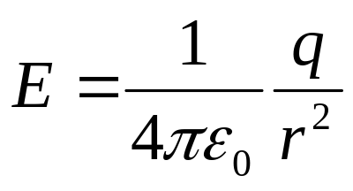
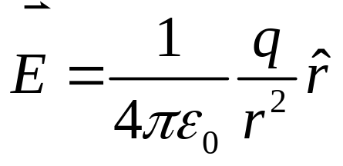
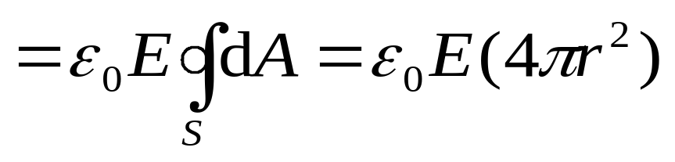
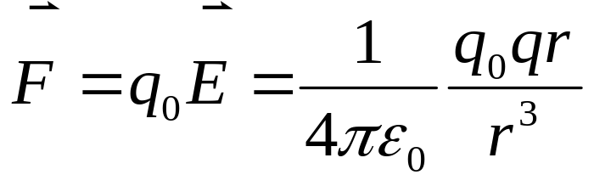
It follows from the spherical symmetry of the charge distribution, we see,
dA
(4) can derive Coulomb’s law.

Slide 20
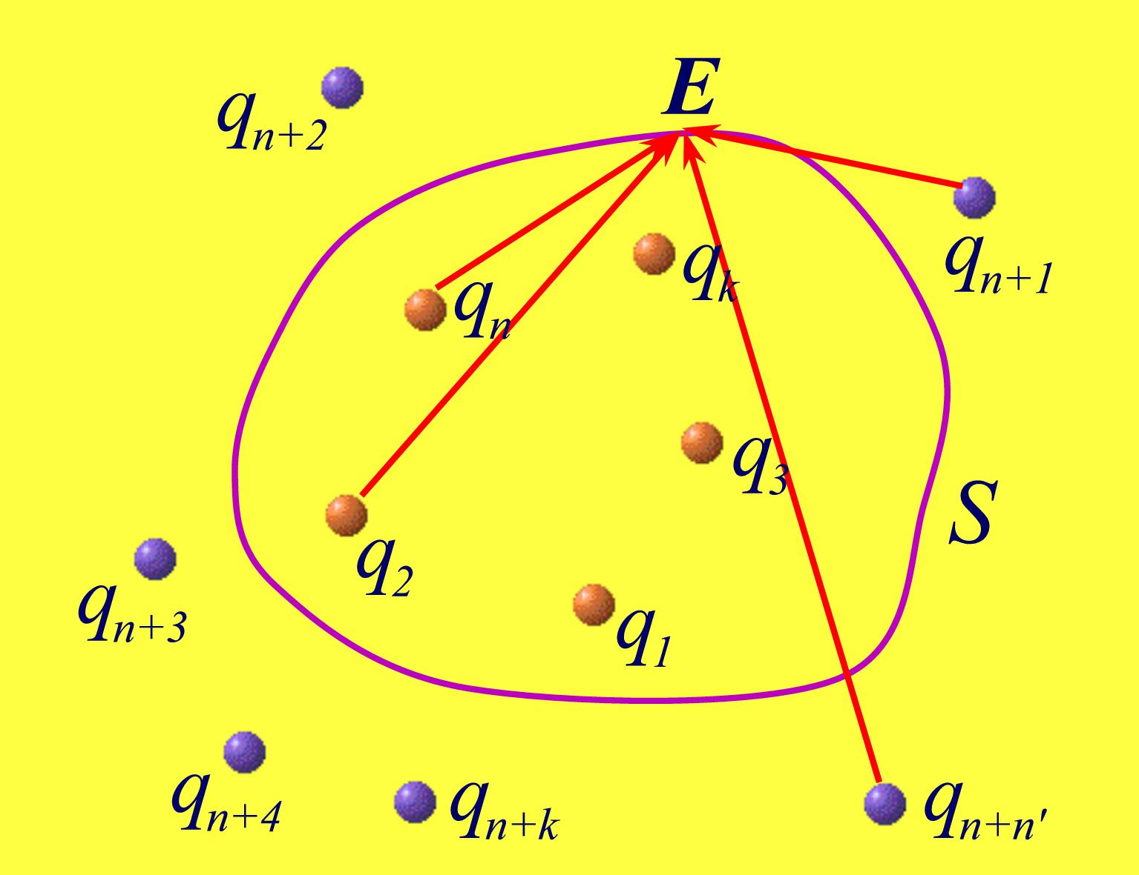
Gauss’ Law
The total flux of an electric field through a closed surface is directly proportional the net charge enclosed by this surface:
The electric field strength E in Gauss law is the resultant field strength, although its flux depends only on the net charge inside Gauss surface A.

Slide 21
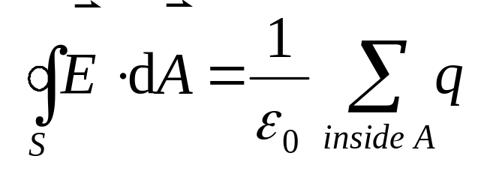
Applications of Gauss’ Law
Gauss’ law holds for any closed surface.
To evaluate the electric field by using Gauss’ law, however,
the Gauss surface should be chosen so that the symmetry of the charge distribution gives, on at least part of the surface, an electric field of constant magnitude,
which can then be factored out of the surface integral.

Slide 22
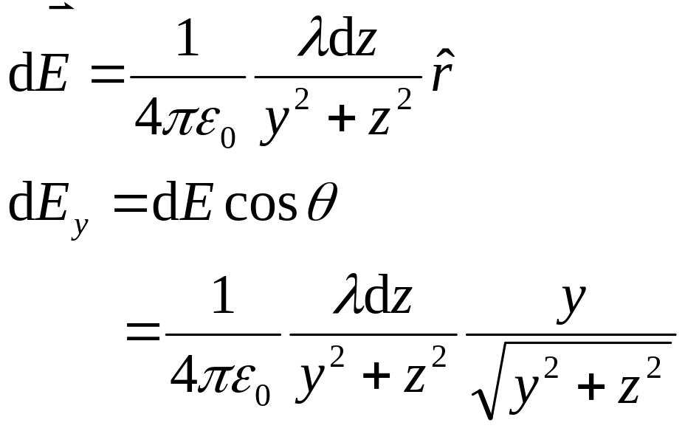

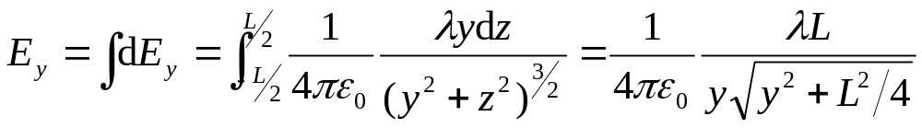
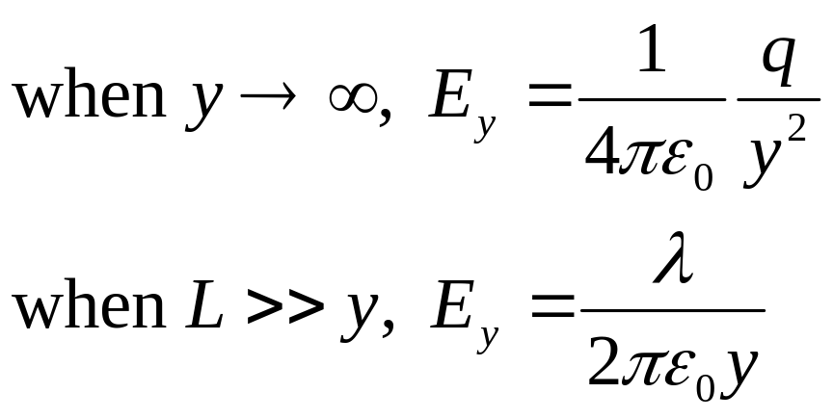
1. Infinite Line of Charge
λ

Slide 23







1. Infinite Line of Charge
λ

Slide 24






2. Infinite Sheet of Charge
A non-conducting and infinite sheet of charge distribution, with a constant positive surface charge density σ .
Therefore, the relevant Gauss surface is a closed cylinder of cross-sectional area A.

Slide 25




3. A uniformly Charged spherical shell
Suppose that the total charge on the shell is q .
Therefore, Gauss surfaces should be the co-centric spherical surfaces, with radiuses 0<r<R and R<r<∞ respectively:

Slide 26











4. Spherically symmetric charge distribution
Suppose that the total charge on the sphere is q,
Therefore, Gauss surfaces should be the co-centric spherical surfaces, with radiuses 0<r<R and R<r<∞ respectively.
In case of R<r<∞,

Slide 27










Example

Slide 28





Example

Slide 29






Example

Slide 30


Example

Slide 31


Example

Slide 32
Example

Slide 33
Exercises
P629 2, 7, 12,
Problems
P632 6, 8

Slide 34
Gauss’ Law
The total flux of an electric field through a closed surface is directly proportional the net charge enclosed by this surface:
Gauss’ law is more general than Coulomb’s law.
Coulomb’s law

Slide 35










Gauss’ Law and conductors
Before entering the electric field, the conductor is electricity-neutral, although there are about 10²³ free electrons within it.
When entering the external
electric field E₀, the field will exerts a force F=-eE₀ on electrons.
The electrons quickly move to the left surface of the conductor, leaving a deficiency of electrons on the right surface (induction charges).
When the E' is equal to E₀, the electrons is not moving. This is Electrostatic equilibrium .
Within the conductor, the induction field E' is opposite to E₀.
The net field in the conductor is,

Slide 36



Therefore, the electrostatic equilibrium is achieved only if, everywhere inside the conductor.
2. The properties of the isolated conductors in electrostatic equilibrium
For a conductor having an internal cavity
There is no charge in the interior of the conductor.
The excess charge must be on the actual outer surface of the conductor.

Slide 37

Therefore, the electrostatic equilibrium is achieved only if, everywhere inside the conductor.
2. The properties of the isolated conductors in electrostatic equilibrium
For a conductor having an internal cavity
Gauss’ law implies that there is no net charge on the surface of the interior cavity
There is no charge in the interior of the conductor.
The excess charge must be on the actual outer surface of the conductor.
If there is an object with charge q inside the cavity

Slide 39






On conductor’s surface
By considering the following cylinder as Gaussian surface
Example: For a conducting sphere,
E

Slide 40
Example
-
+
-
+
-
+
-
+
-
E
-
+
-
+
-
+
-
+
-
+
-
+

Slide 41
Example
+
+
+
-
+
+
-
-
-
-
+
+
-
-
-q’
+q’
+
-
-
+
+q’
-
-
+
+
-
-
-
-
+
+
-
+
+
+

Slide 42
Example
-
-
-
-
-
-
-
-q’
-
-
+q’
-
-
-
-
-
-
-

Slide 43
Example
-
-
-
-
-
-
-
-q’
-
-
+q’
-
-
-
-
-
-
-

Slide 44
Example
-
-
-
-
-
-
-
-q’
-
-
-
-
-
-
-
-
-

Slide 45
Example
q<q’
-
-
q=q’
+
+
-
+
-
-
-
+
+
-
-
-
-
-
-
-q’
+
+
-
-
q-q’
-
-
-
+
-
+
+q
-q
-
-
-
-
+
+
-
-
-
-
-
+
+
-
-
+
+
-
+
-
-

Slide 46
Example
q>q’
q=q’
+
+
+
-
+
+
-
-
-
-
-q’
+
+
-
-
q-q’
+
-
-
+
+q
-q
-
-
+
+
-
-
-
-
+
+
-
+
+
+

Slide 47






L R
E_{L}
E_{L}
E_{L}
E_{R}
E_{R}
E_{R}
A B C

